Slide 1
All India Gold Community With Karigar Fraud Blacklist
Name of Member :
1. Aishwarya Pangale
2. Pallavi Narkhede
3. Bhavana Tongale
Guide :
Mrs. Leena R. Waghulde

Slide 2
CONTENT
Introduction
Problem Definition
Literature Survey
Presently Available System
Proposed System
Software And Hardware Requirements
Architecture
ER-Diagram
DFD 0 Level Diagram
DFD 1 Level Diagram
DFD 2 Level Diagram
Use Case Diagram
Sequence Diagram
Expected Result
References

Slide 3
INTRODUCTION
In the evolving landscape of the gold industry, the ‘All India Gold Community with Blacklist Karagir’ project emerges as a ground breaking solution to empower gold Dukandar, Karigar and Vyapari across India.
All India Gold Community with Blacklist Karagir to establish a comprehensive platform that bridges the gap between Dukandar, Karigar and Vyapari ensuring transparency, security, and ethical practices within the gold trade.

Slide 4
PROBLEM DEFINITION
In the “All India Gold Community With Karigar Blacklist System” Using machine learning techniques, karigar can be added to the blacklist based on their past behavior and data.
For example, we can apply supervised learning models like logistic regression, random forests, or others for this purpose.

Slide 5
LITERATURE SURVEY
Sr No. | Name of Scientices | Working | Advantages
1. | Mr. Manish Bhadane | Design a system that provides a robust, cost effective, efficient, yet accurate solution for fraud detection | Financial services are used everywhere and operate in a very complex manner
2. | Mostafa A. Ali | Reviewed different types of fraud and attacks detection system as well as some preventive measures in place to secure e-banking services | E-banking gives customers a lots of satisfaction in terms of getting a better service quality
3. | Magdalena Roode | Investigates the employee-employer relationship, focusing specifically on trust | Easy to maintain the relationship and trust on employee

Slide 6
PRESENTLY AVAILABLE SYSTEM
Just has bank fraud happen in the world as well as gold also happened. This project was not continuous before and there was no mechanism for identification and verification. And there also no automation system.
Gold related fraud work going on but fraud karigar and vyapari was not going in blacklist, he was easily getting any work hence, we are developing All India Gold Community With Karigar Blacklist.

Slide 7
PROPOSED SYSTEM
All India Gold Community With Karigar Blacklist in this system there are three users like Dukandar, Karigar and Vyapari.
Dukandar: Dukandar search the karigar by work fields. Then if Karigar and Vyapari does fraud work that time dukandar add karigar and vyapari to blacklist.
Karigar: Karigar search the job and view and apply for the job.
Vyapari: Vyapari give work to the dukandar.

Slide 8
SOFTWARE AND HARDWARE REQUIREMENT
Microsoft Windows 10 (32 or 64 bit).
8GB RAM recommended.
500 MB disk space
VS Code Software
XAMPP Server

Slide 9
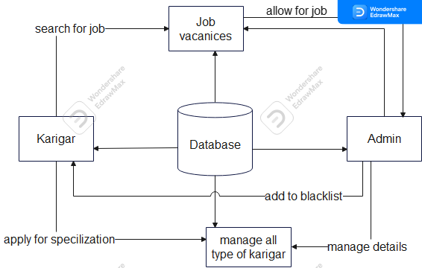
Architecture

Slide 10
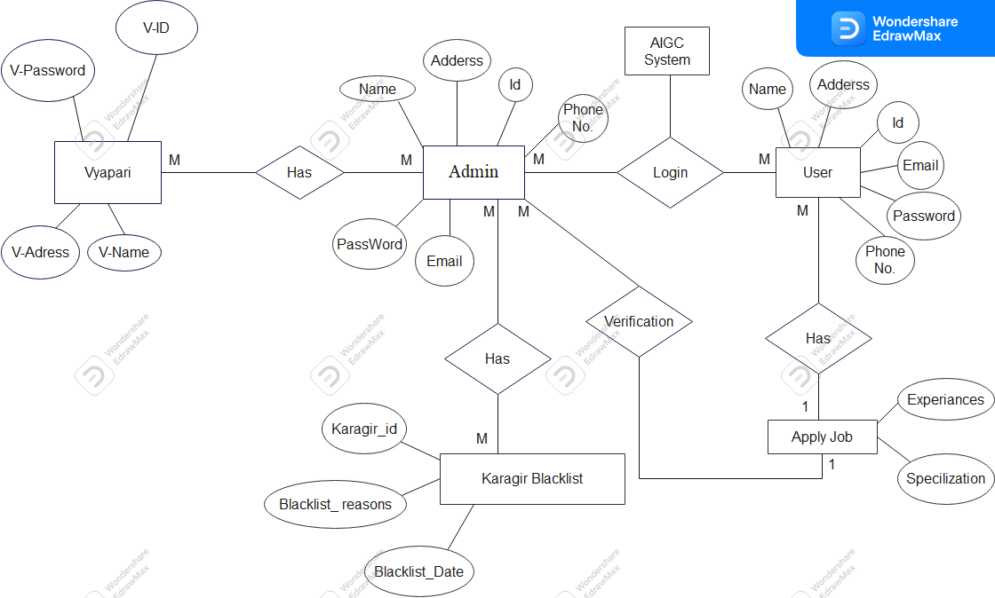
ER Diagram

Slide 11

DFD 0 Level Diagram

Slide 12
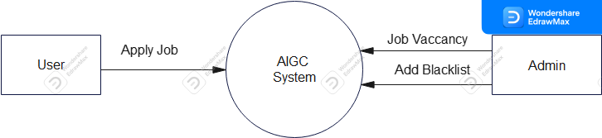
DFD 1 Level Diagram

Slide 13
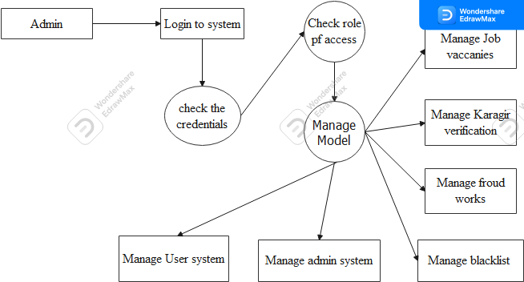
DFD 2 Level Diagram
https://www.guru99.com/business-intelligence-definition-example.html

Slide 14
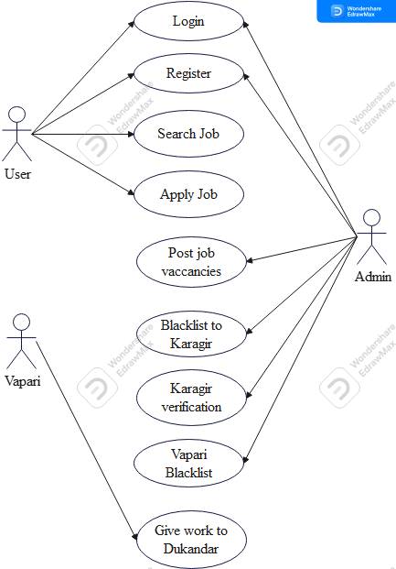
Use Case Diagram

Slide 15
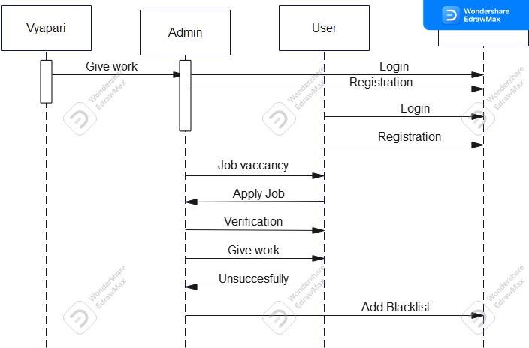
Sequence Diagram

Slide 16
EXPECTED RESULT
Karigar Data: we will need to collect data on karigar, including their names, addresses, contact details, work status, and information about their behaviour.
Training Data: Using Machine learning we will train the model on the training data so that it can predict the behaviour of karigar for including in the blacklist.
Blacklist: To include karigar in the blacklist, generate a blacklist that includes their details and reasons for inclusion.

Slide 17
REFERENCES
1. K.Chaudhary, J.Yadav, “A review of fraud: Acomparative study.”decis . Support system, vol 50, no3, pp.602-613,2011
2. Katherine J. Barker , Jackie D’Amato ,Paul Sheridon,2008 “Credit card fraud :awareness and prevention”, Journal+- of financial Crime ,Vol. 15issue:4,pp.398-410
3. Bell, C. 2001. Elements of trust. Executive Excellence 18(4):10.
4. Boss, RW. 1978. Trust and managerial problem solving revisited. Group and Organization Studies 3: 331-342.
5. Kumar, N. 1996. The Power of Trust in Manufacturer-Retailer Relationships. Harvard Business Review (November-December): 92-106.

Slide 18
Thank You

